Slide 1

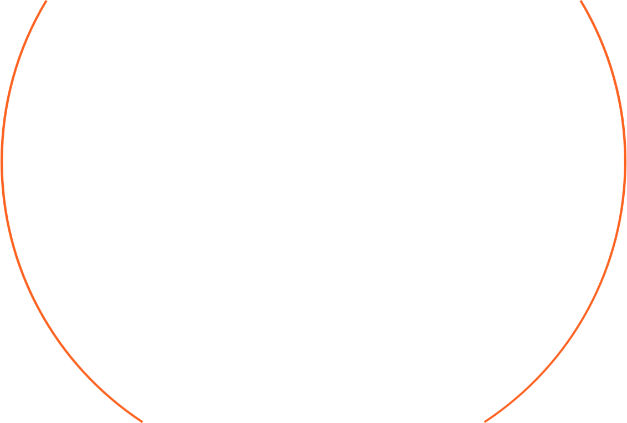

B.Tech (7th Semester) Project Presentation
of the project entitled
"A Comprehensive Study on the Interdependence of Memory Window Behaviour and Ferroelectric Properties in FETs"
By
Dipankar Deori (Scholar ID-2114150)
Palash Mandal (Scholar ID-2114128)
Under the supervision of
Dr. Dipjyoti Das
Electronics and Communication Engineering Department
National Institute of Technology Silchar, Assam

Slide 2

Table of Contents
1. Introduction
2. Literature Review
3. Problem Statement
4. Progress
5. Methodology

Slide 3


Introduction
2020
1.7 MB data per sec
2.5 quintillion bytes per day
“90% of data in the world was generated over the last 2 years”: Forbes
Notes:
Now we all know that presently we are living in a big data era where we are generating a huge amount of data every single day. If we simply talk about a social media platform such as facebook or youtube, millions of users connect on a daily basis, share various information and these numbers are increasing day by day. Just to put things in perspective in 2020, every person generated 1.7 MB of the data in just a second whereas almost 2.5 quintillion bytes of data was generated by interest users every single day. As per Forbes report, almost 90% of the data in the world was generated over the last two years.

Slide 4
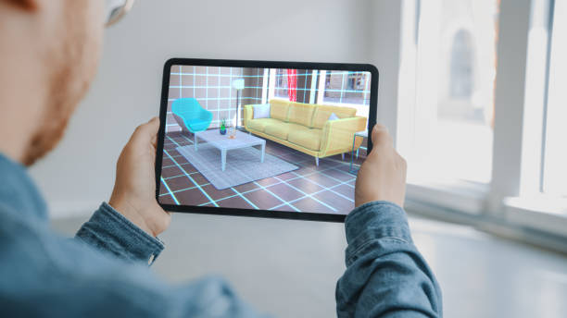



Introduction
Augmented Reality
Virtual Reality
Smart Cities
Autonomous Transportation
With the excitement about the upcoming paradigm such as IoT, Augmented or virtual reality, smart cities, autonomous transportation etc, a date explosion is set to take place
Notes:
Considering the fact that the world is moving towards digitization at an unprecedented rate and the excitement about the upcoming paradigm such as IoT, Augmented or virtual reality, smart cities, autonomous transportation etc, a date explosion is set to take place

Slide 5
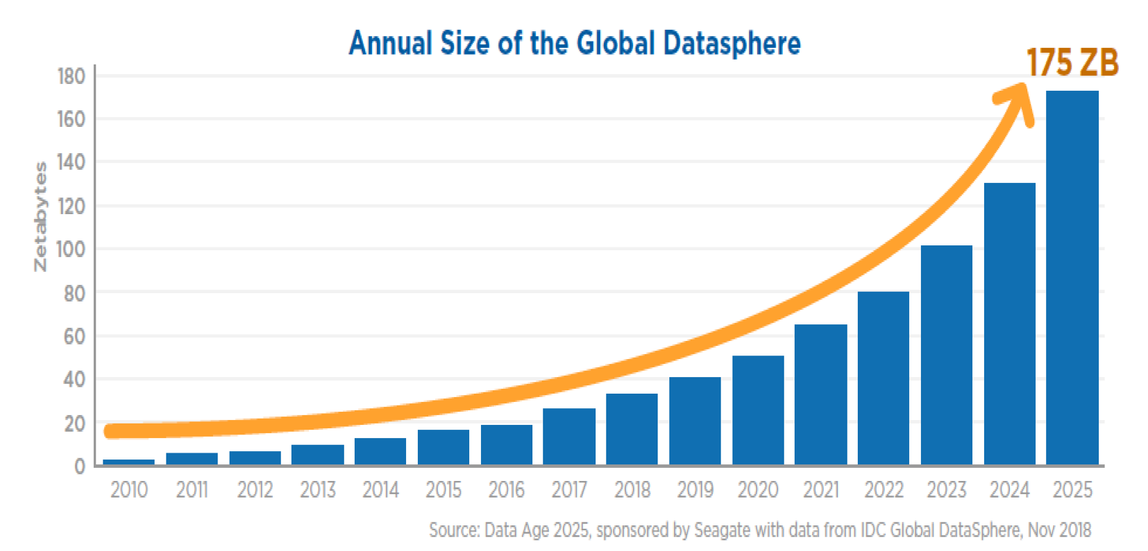
Introduction
More data we collect
More data needs to be processed and stored
Handling and Processing of Data is going to be a key challenge to the microelectronics industry
Notes:
It has been predicted that the annual size of global datasphere will reach 175 ZB by the year 2025. Now more the data we collect, more data needs to be stored and processed. Moving forward, one of the key challenge of the Microelectronics industry is therefore going to be how to handle the huge amount of data and through what medium or tools the data is processed and stored.

Slide 6
Ideal Memory
Non-Volatility
Density
Energy Efficiency
Affordability
Speed
Reliabilty
Properties of universal / ideal memory

Slide 7
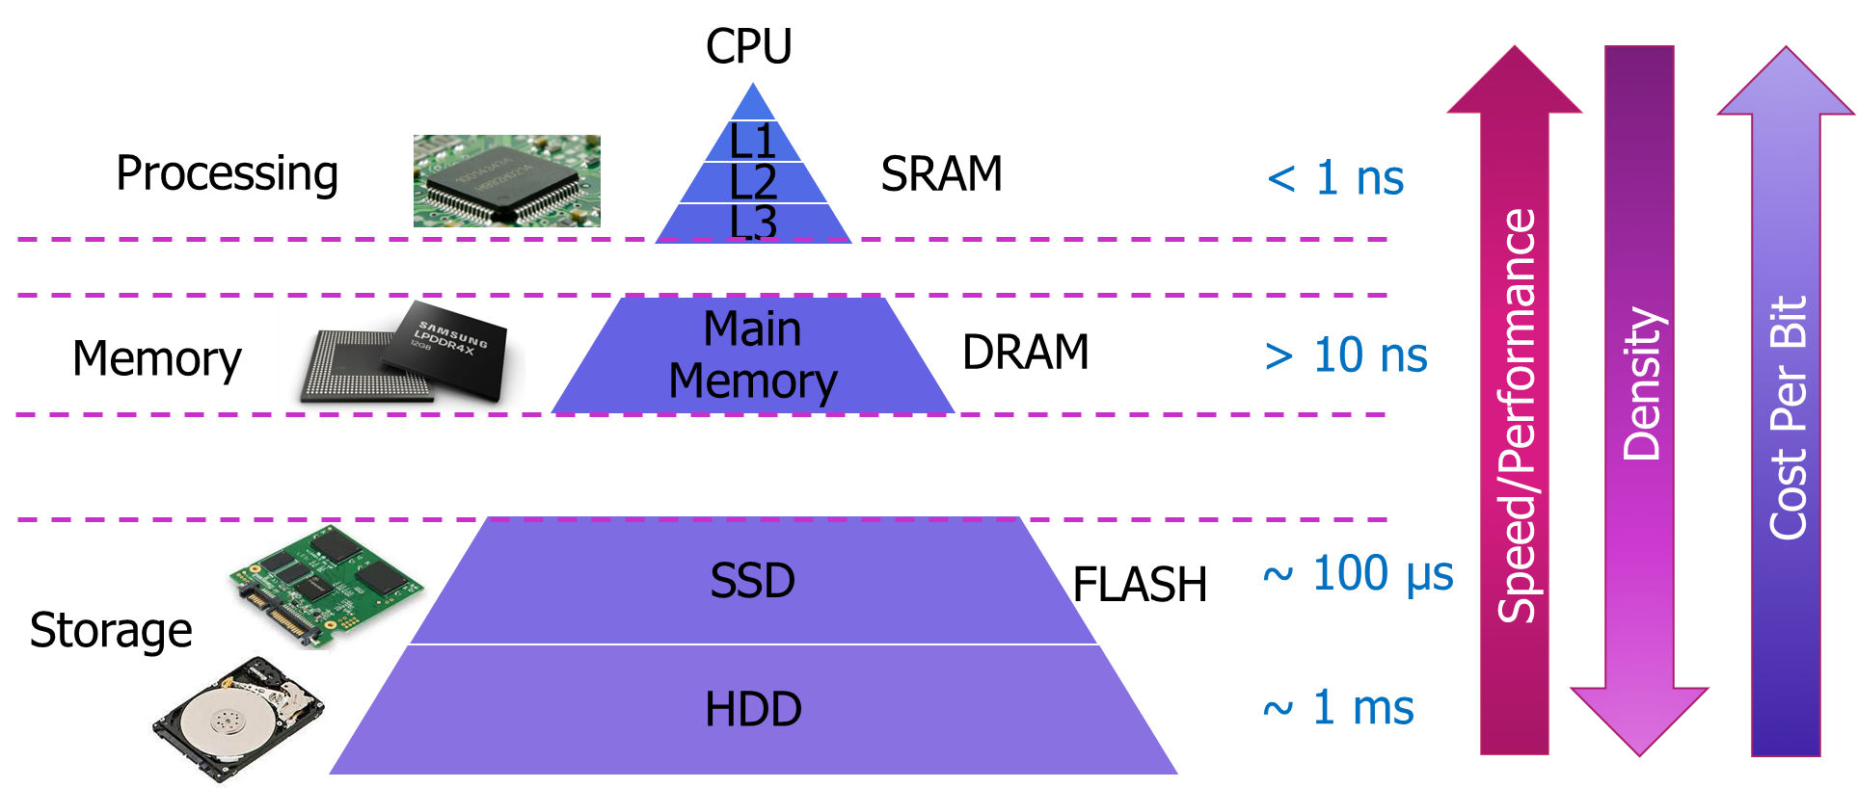
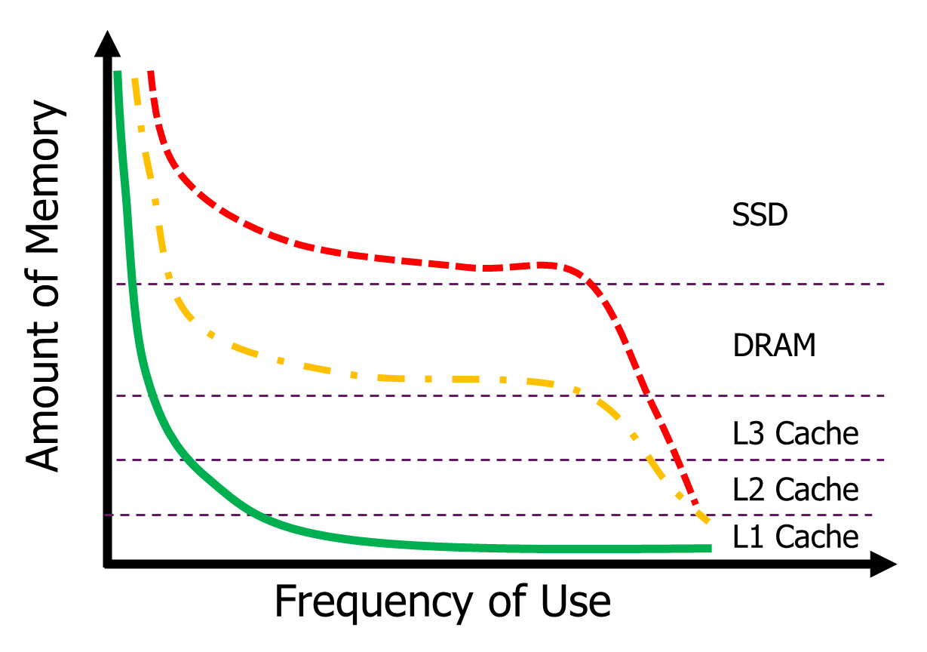
The Memory Hierarchy
Emerging Memories
Emerging Memories
Scaling limit of market dominant technologies such as SRAM, DRAM and FLASH and performance gap in memory hierarchy provides market for emerging memory technologies

Slide 8
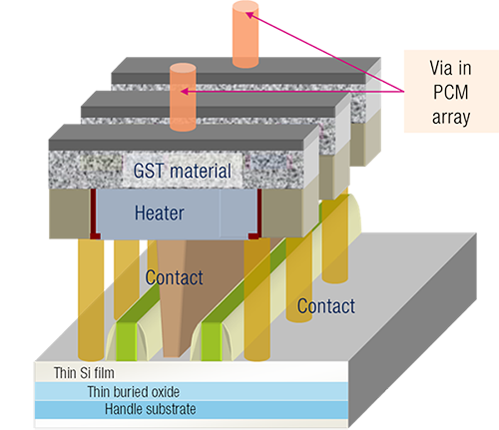
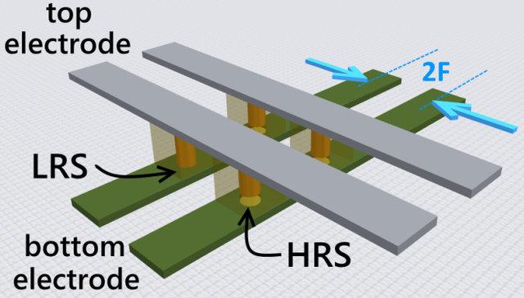
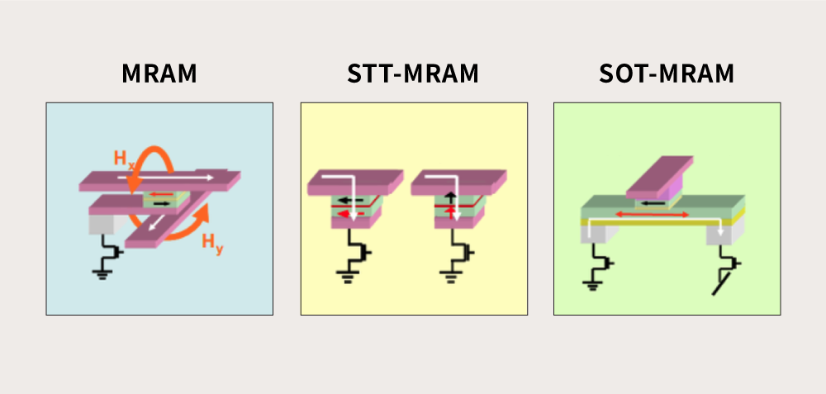
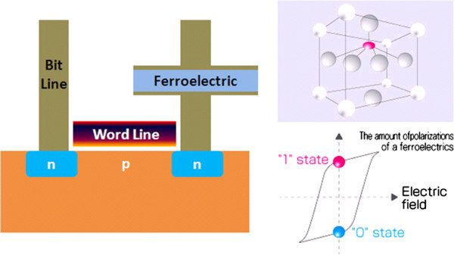
Emerging Memory Solutions
Resistive RAM (RRAM)
Phase Change Memory (PCM)
Magnetic RAM (MRAM)
Ferroelectric Memories
RRAM, PCM & MRAM are current controlled devices whereas Ferroelectric Memories are voltage-controlled devices

Slide 9
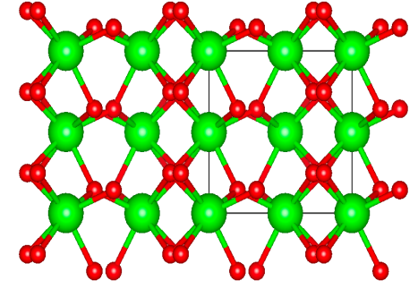
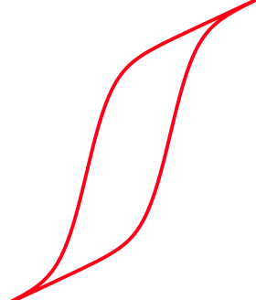

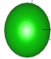

Ferroelectrics for memory and storage
P
Polarization, P
-P
Voltage, V
Hf⁴⁺
O²⁻
Ferroelectric Memories
Ferroelectric materials have spontaneous electric polarization that can be reversed by applying an external electric field of critical value (coercive field)
Notes:
Ferroelectric memories are basically based on ferroelectric materials that has two different polarization states which can be altered by applying electric field. So, ferroelectric memories stores data in the form of polarization.

Slide 10
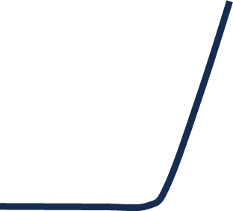
Ferroelectrics for memory and storage
V_{G}
V_{s}(GND)
V_{D}
P
Polarization, P
I_{D}
-P
Voltage, V
Hf⁴⁺
O²⁻
Ferroelectric Memories
V_{T}
Ferroelectric memories store data in the form of polarization
Notes:
Now this is the Id-Vg characteristics of a normal FET.

Slide 11
Ferroelectrics for memory and storage
V_{G}
V_{s}(GND)
Ferroelectric
V_{D}
P
Polarization, P
I_{D}
-P
Voltage, V
Hf⁴⁺
O²⁻
Ferroelectric Memories
V_{T}
Ferroelectric memories store data in the form of polarization
Notes:
Now, if we put a ferroelectric layer in the gate stack of a FET,

Slide 12
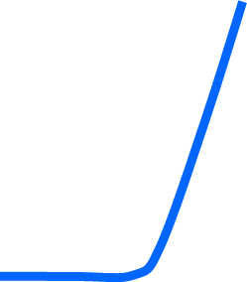
Ferroelectrics for memory and storage
V_{G}
V_{s}(GND)
Ferroelectric
V_{D}
P
Polarization, P
I_{D}
-P
Voltage, V
P (down)
P (up)
Hf⁴⁺
O²⁻
MW
Ferroelectric Memories
V_{TL}
V_{TH}
Ferroelectric memories store data in the form of polarization
Notes:
depending on the state of polarization of the ferroelectric material we can get a Vt shift which leads to a MW and the FET can behave as a memory device. Now despite hitting the market in late 90s and early 2000, ferroelectric memories never received commercial success due to the scaling and compatibility issues of conventional perovskite

Slide 13
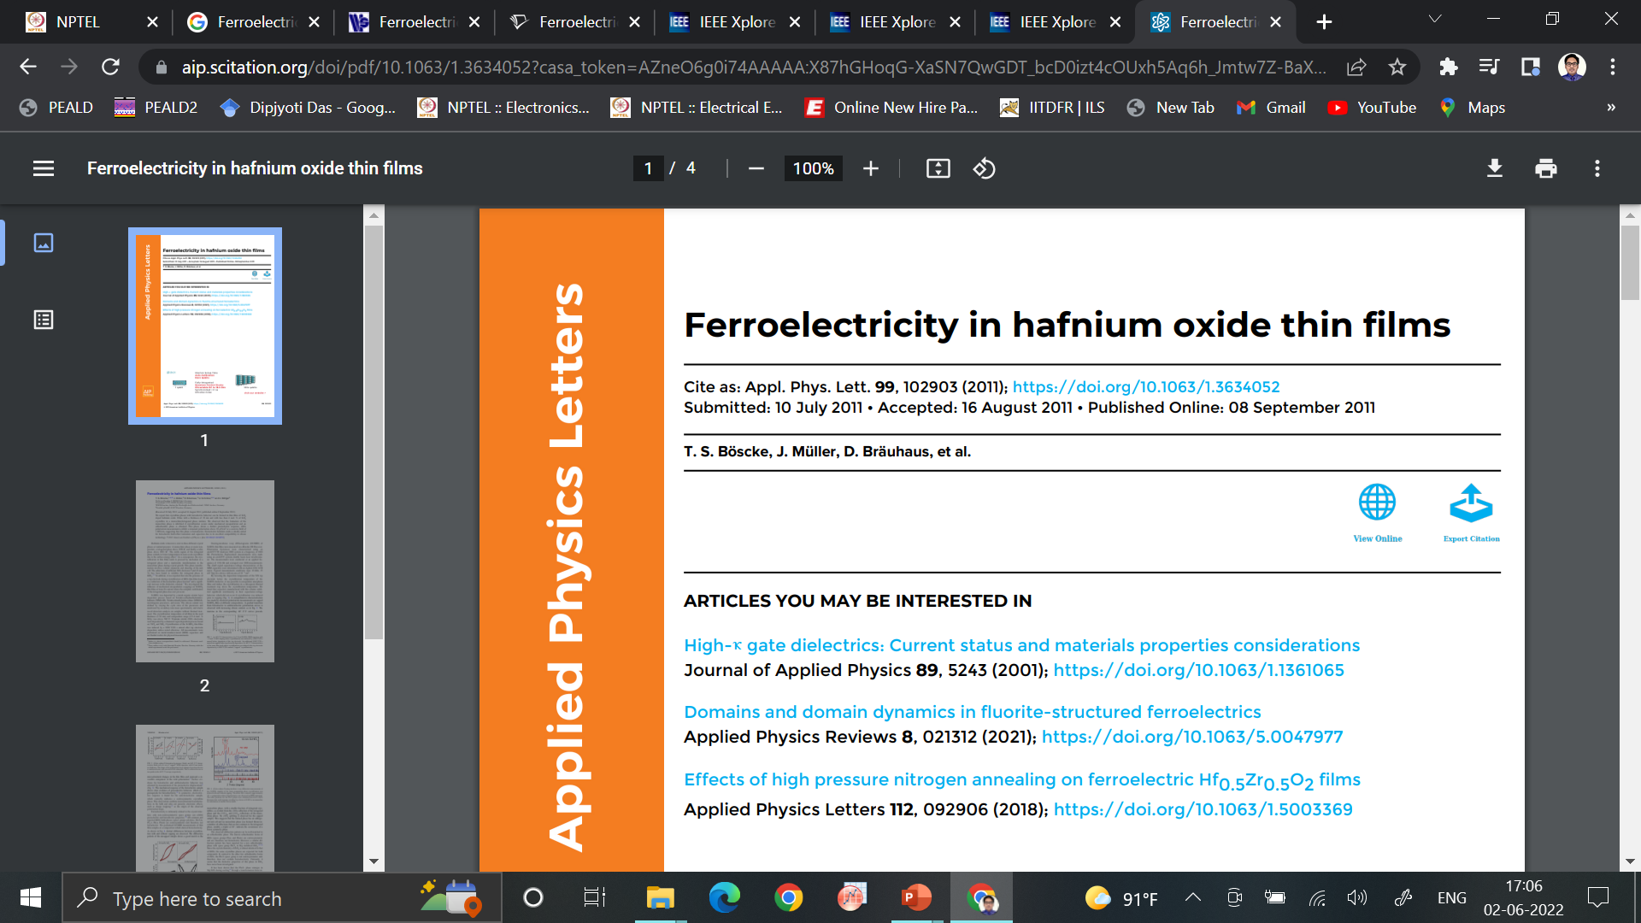
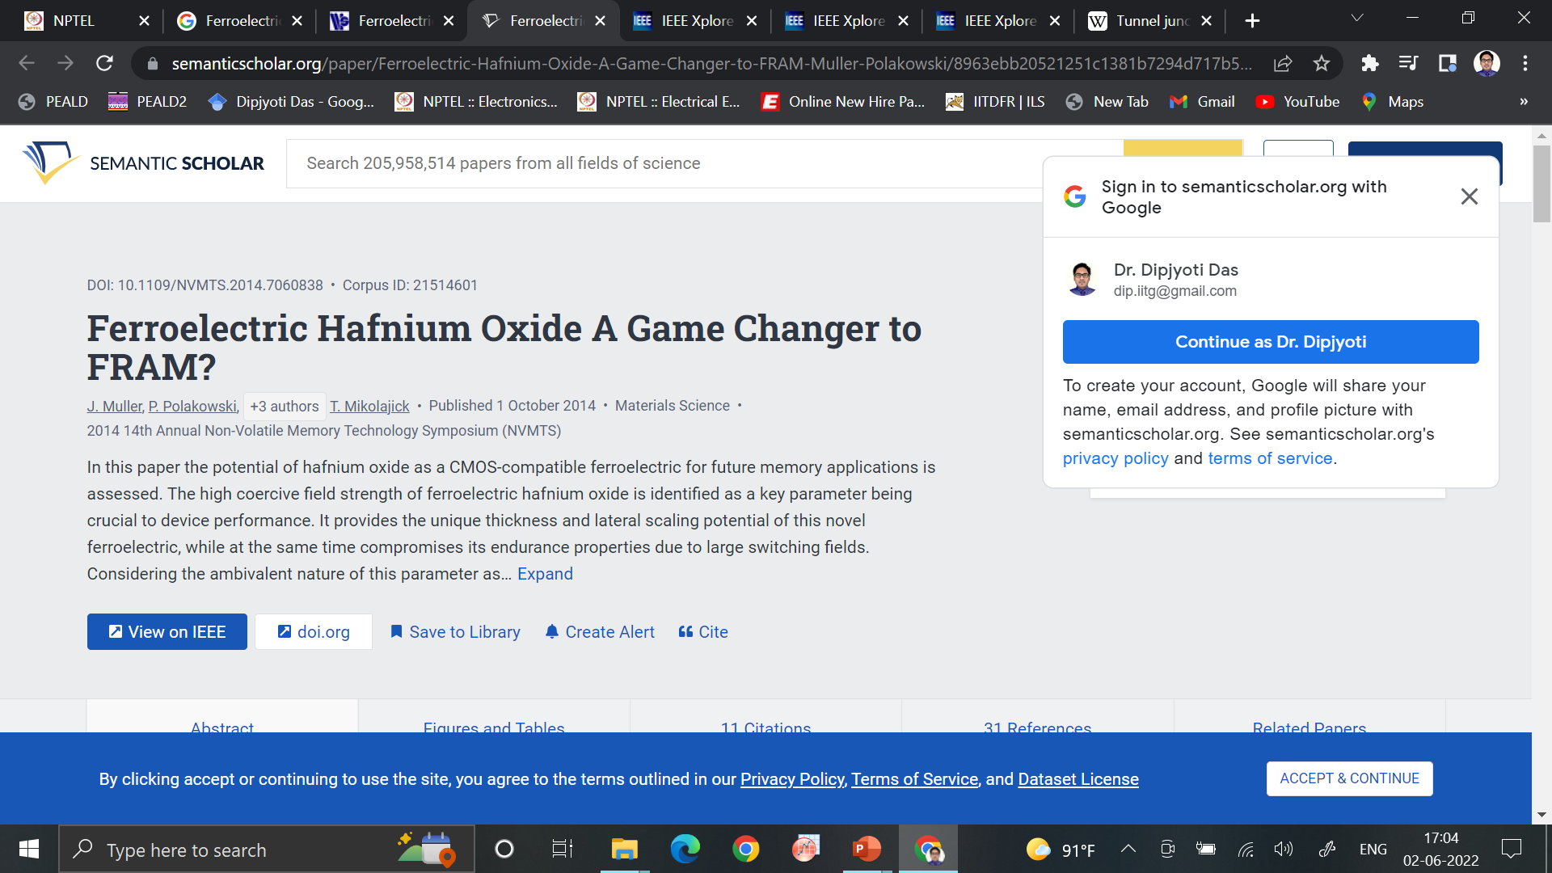
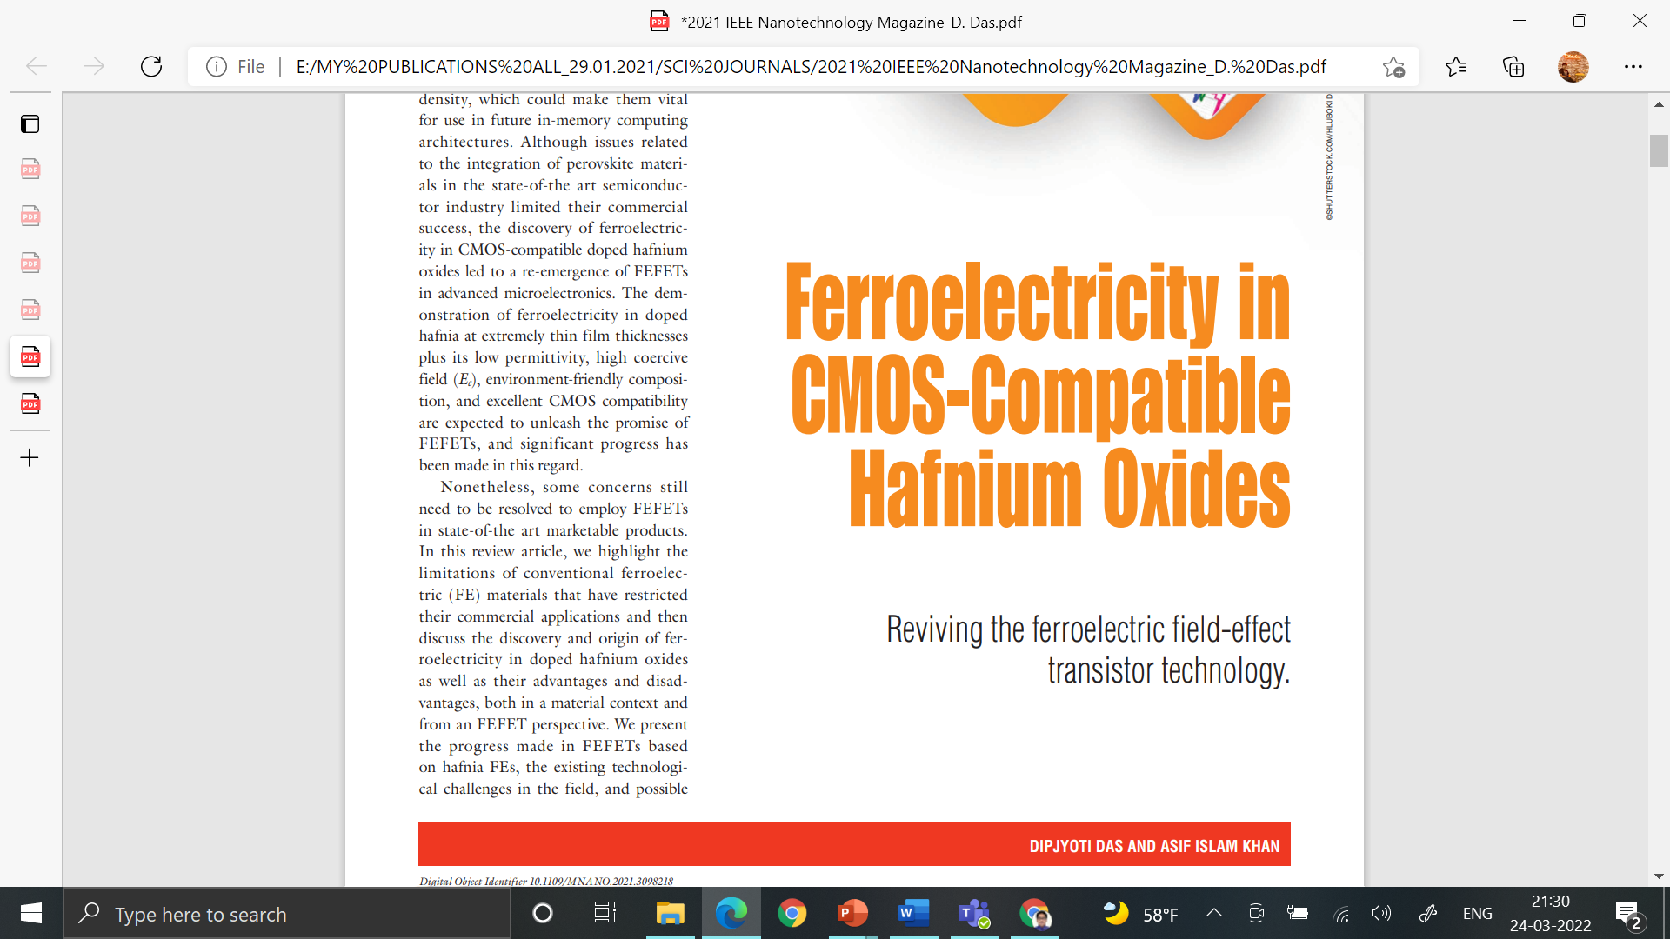
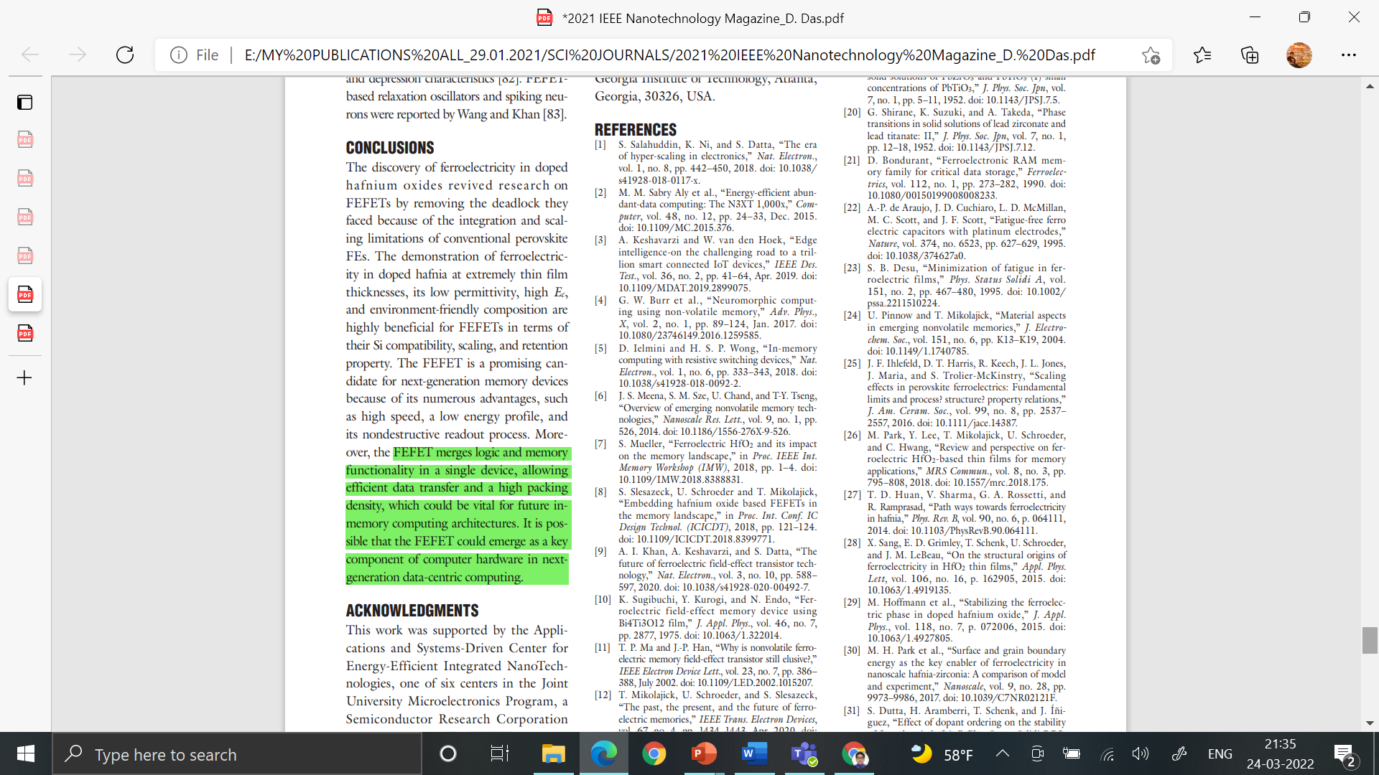
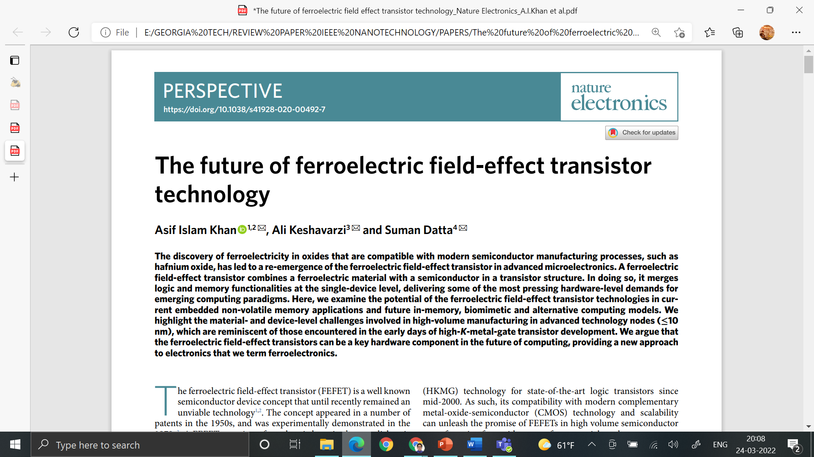
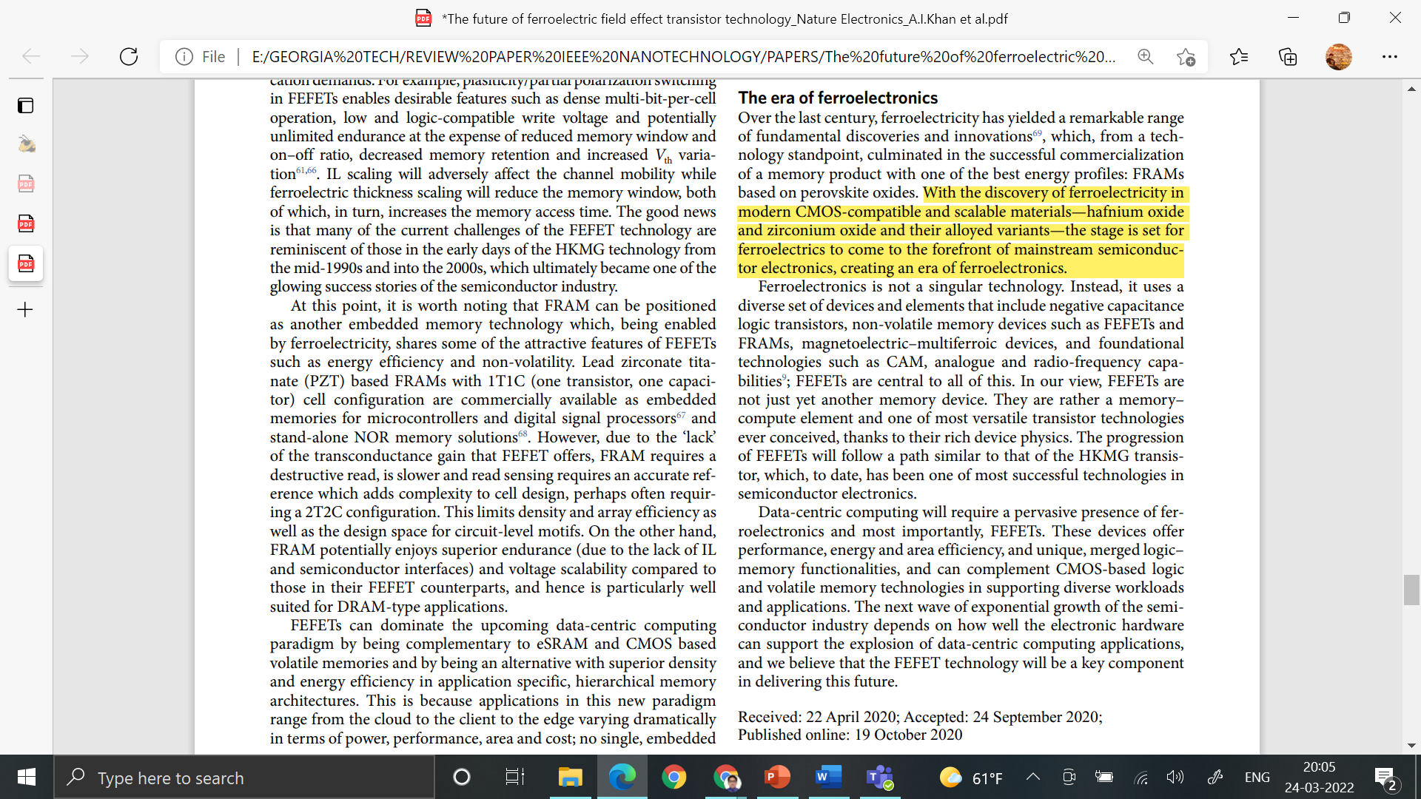
Literature Review
The discovery of ferroelectricity in CMOS-compatible doped hafnium oxides led to a re-emergence of ferroelectric memories in advanced microelectronics
Notes:
However, the discovery of ferroelectricity in CMOS compatible hafnia is considered to be a game changer in the field of ferroelectric memories and it has led to the re-emergence of ferroelectric memories in advanced microelectronics

Slide 14
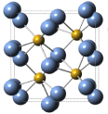
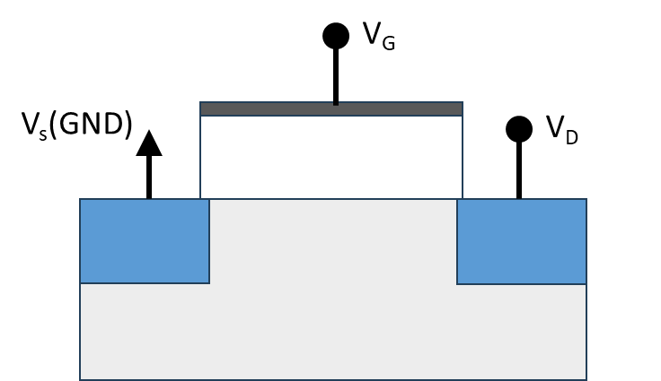
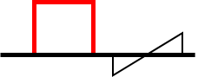
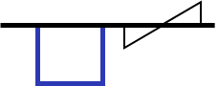
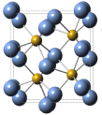
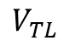
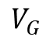
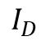

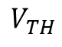
Problem Statement: Ideal FET MW
P_{S}
PGM
(+ve)
ERS
(-ve)
$$I_{D}$$
Ferroelectric
Hysteresis
MW
$$V_{G}$$
$$V_{TL}$$
$$V_{TH}$$
MW$=2V_{c} or=2E_{c}∗t_{f}$
MW of ideal FEFET is $2E_{c}∗t_{f}$ where E_{c}is the coercive field (E_{c}) and t_{f} is the thickness (t_{f}) of the FE layer
Notes:
One of the primary difficulties lies in the trade-off between achieving the theoretical maximum MW, which can be represented as 2Ec ∗ tf and maintaining an appropriate thickness for the FE layer.
Further, the practical MW is often lower than the theoretical limit due to charge injection and trapping effects And if we consider Si FEFET with 20 nm thick FE layer, the maximum MW we can get is somewhere around 2.5-3V. Therefore we need to design novel gate stacks to meet up the MW requirement

Slide 15


Practical FET MW
P_{S}
PGM
(+ve)
ERS
(-ve)
$$I_{D}$$
Ferroelectric
Hysteresis
IL
MW
$$V_{G}$$
$$V_{TL}$$
$$V_{TH}$$
MW$<2V_{c} or<2E_{c}∗t_{f}$
MW of in practical FEFET is limited charge injection/ trapped charges at the semiconductor/ Ferroelectric interface
Notes:
One of the primary difficulties lies in the trade-off between achieving the theoretical maximum MW, which can be represented as 2Ec ∗ tf and maintaining an appropriate thickness for the FE layer.
Further, the practical MW is often lower than the theoretical limit due to charge injection and trapping effects And if we consider Si FEFET with 20 nm thick FE layer, the maximum MW we can get is somewhere around 2.5-3V. Therefore we need to design novel gate stacks to meet up the MW requirement

Slide 16
Progress
Timeline | Task | Progress
1 st July-30 th August | Study of MOS device physics Literature Review and Basic Understanding of Ferroelectric | Basic understanding of ferroelectricity, MOS Device Physics
1st September-Present | Literature Review on the MW limiting factors of FEFET Basic TCAD modelling of MOSFET
MW of FEFET is limited by the coercive field (E_{c}) and the thickness (t_{f}) of the FE layer
Notes:
One of the primary difficulties lies in the trade-off between achieving the theoretical maximum MW, which can be represented as 2Ec ∗ tf and maintaining an appropriate thickness for the FE layer.
Further, the practical MW is often lower than the theoretical limit due to charge injection and trapping effects And if we consider Si FEFET with 20 nm thick FE layer, the maximum MW we can get is somewhere around 2.5-3V. Therefore we need to design novel gate stacks to meet up the MW requirement

Slide 17
Methodology
Modelling of MOSFET
MOSFET with Fixed Charge
Practical FEFET
Modelling of Ideal FEFET & correlate Memory Window (MW)

Slide 18
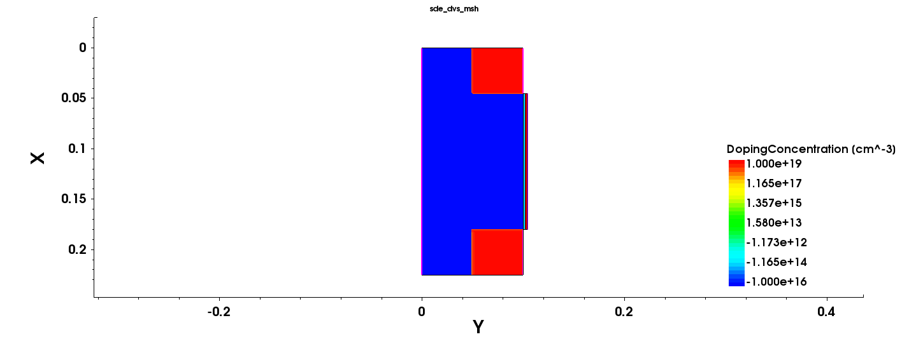
TCAD Modelling of a MOSFET (Structure)
Doping concentration(cm ^-3)
Source = Arsenic active concentration 1e+19
Channel = Boron active concentration 1e+16
Drain = Arsenic active concentration 1e+19
Body(substrate) = Boron active concentration 1e+16
MW of FEFET is limited by the coercive field (E_{c}) and the thickness (t_{f}) of the FE layer
cm ^
Notes:
One of the primary difficulties lies in the trade-off between achieving the theoretical maximum MW, which can be represented as 2Ec ∗ tf and maintaining an appropriate thickness for the FE layer.
Further, the practical MW is often lower than the theoretical limit due to charge injection and trapping effects And if we consider Si FEFET with 20 nm thick FE layer, the maximum MW we can get is somewhere around 2.5-3V. Therefore we need to design novel gate stacks to meet up the MW requirement

Slide 19
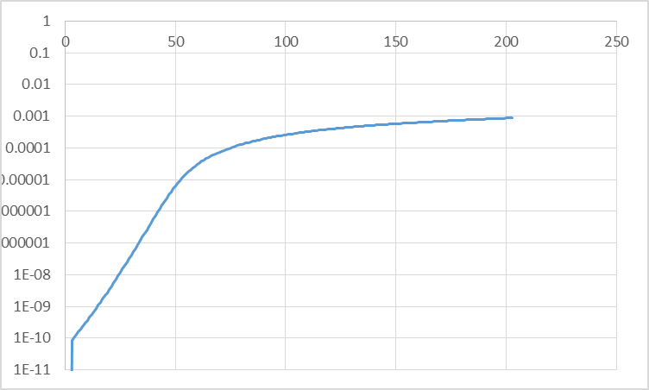
TCAD Modelling of a MOSFET (Id-Vg)
Doping concentration(cm ^-3)
Source = Arsenic active concentration 1e+19
Channel = Boron active concentration 1e+16
Drain = Arsenic active concentration 1e+19
Body(substrate) = Boron active concentration 1e+16
MW of FEFET is limited by the coercive field (E_{c}) and the thickness (t_{f}) of the FE layer
Notes:
One of the primary difficulties lies in the trade-off between achieving the theoretical maximum MW, which can be represented as 2Ec ∗ tf and maintaining an appropriate thickness for the FE layer.
Further, the practical MW is often lower than the theoretical limit due to charge injection and trapping effects And if we consider Si FEFET with 20 nm thick FE layer, the maximum MW we can get is somewhere around 2.5-3V. Therefore we need to design novel gate stacks to meet up the MW requirement

Slide 20
THANK YOU

